Slide 1

REGISTER TO VOTE
Don’t forget to register to vote before 26 November in order to be able to vote in the upcoming General Election on 12 December.
Remember: You can register to vote at both your home and university addresses and can then choose which place to vote.
Either visit gov.uk/register-to-vote or come along to Room 157 at Psychology from 12.30pm to 1.30pm this week and enjoy a biscuit and register to vote with a member of staff.

Slide 2

Strike #1
Nov 25 – Dec 4, 2019
Complain to John Brady j.j.brady@reading.ac.uk

Slide 3
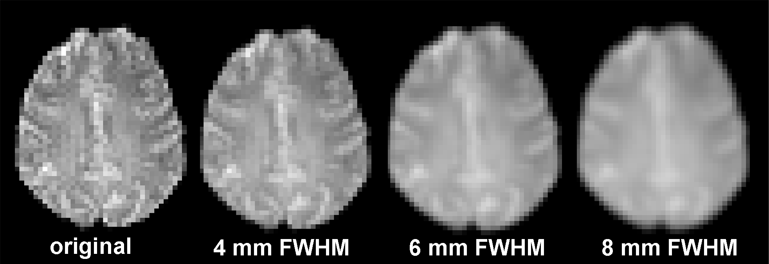

Preprocessing and detecting activation using FSL (FEAT)
David Field
Notes:
FEAT stands for FMRI Expert Analysis Tool (not one of their better acronyms…but not as bad as FLOBS)
A single session is one 4D functional time series acquired from one subject. If you have two subjects, or two sessions from a single session then this is “multi-session” FMRI – see next week. Note that it is still multi session if the same participants stayed in the scanner between sessions, i.e. you stopped the scanner and started it again. Single session analysis is also referred to as first level analysis, and multi-session analysis is also referred to as second level analysis or higher level analysis. (you can technically have 3rd and 4thlevel…)

Slide 5
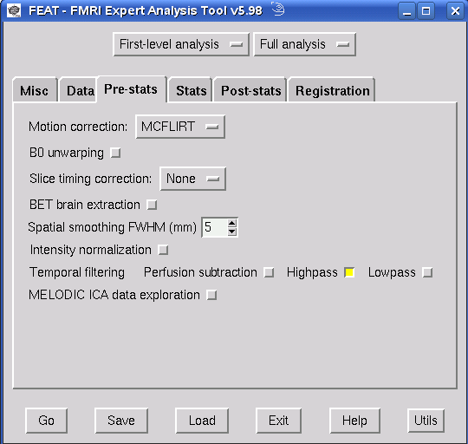
Notes:
When you run the FEAT GUI you will see a window like this with a number of tabs running across the top. Today, as far as pre-stats is concerned we are NOT interested in
BO Unwarping (this is an option you use if you have acquired a field map in the scanner. the field map is an image of the distortions in the magnetic field of the scanner that were caused by susceptibility artefacts etc at sinuses and ear canals. you can use it to unwarp EPI images so that their shape is more similar to the structural. it gets complex in practice)
Intensity normalization is very out of fashion these days. It forces every FMRI volume to have the same mean intensity. Doh! What if one of them actually has higher mean intensity due to greater activation…this will always be turned off but grand mean scaling is still carried out so that you can compare subject 1 with subject 2 later. this is normalization across all volumes rather than between them, so relative differences in mean intensity between volumes are preserved
Perfusion subtraction is used for ASL (arterial spin labelling) which require the acquisition of an entirely different kind of image from the scanner.
MELODIC is a great way of finding all the sources of variation over time and space in your data using independent component analysis. it will find head motion artefacts just as readily as task related activation. You don’t supply any model, it just searches the data. But the output is hard to make use of…
Motion correction was covered last week. The BET brain extraction option here is for the 4D functional series. You’d normally turn this on. Brain extraction for the structural image that will be used as the target for registration has to be performed by you, BEFORE you use FEAT to set up your processing pipeline.
Today’s lecture will cover motion correction, slice timing correction, smoothing, and temporal filtering
On the Misc tab you can find balloon help. If you want to know more about the options in the FEAT pipeline make sure this is turned on (make the small box yellow)

Slide 6
The BET brain extraction option refers to the 4D functional series
This will not run BET on the structural
Normally turn this on
Brain extraction for the structural image that will be used as the target for registration has to be performed by you, before you use FEAT to set up the processing pipeline

Slide 7
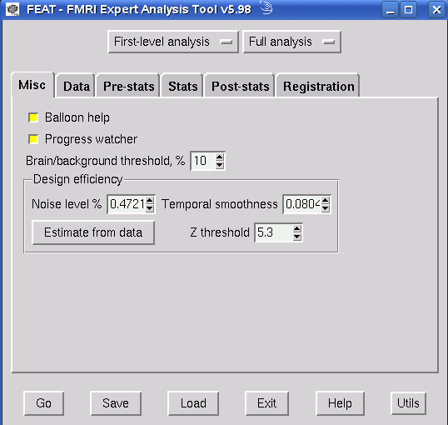
On the Misc tab you can toggle balloon help
Balloon help will tell you what most of the options mean if you hover the mouse over a button or tickbox
But it gets annoying after a while
If progress watcher is selected then FEAT opens a web browser that shows regular updates of the stage your analysis has reached

Slide 8
Motion Correction: MCFLIRT
Aims to make sure that there is a consistent mapping between voxel X,Y,Z position and actual anatomical locations
Each image in the 4D series is registered using a 6 DOF rigid body spatial transform to the reference image (by default, the series mid point)
This means every image apart from the reference image is moved slightly
MCFLIRT plots the movements that were made as output
Notes:
Always remember that motion correction does not work perfectly, especially when motion is large. This is why I find it is really useful to keep scanning the same subjects repeatedly, rather than using fresh ones for every study. Experienced subjects become very comfortable in the scanner environment and learn to lie vey still. They also get better at paying attention to the task rather than the environment they are in. If I had to scan a population that was likely to move a lot I’d first use a biofeedbaack procedure in a mock scanner to “teach” them to lie still.
If you are going to use PACE in the Reading scanner so that you remove motion as you go along by repositioning slices then you really should try to make sure you get the record of adjustments made out of SINGO, otherwise you will have no idea how much your participants actually moved. PACE will be more effective with short TR because the slice position adjustments are made more often.

Slide 9
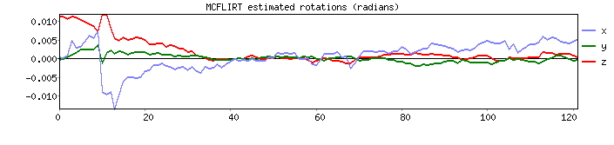
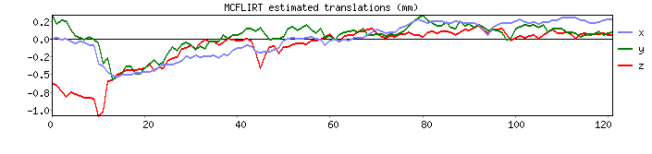
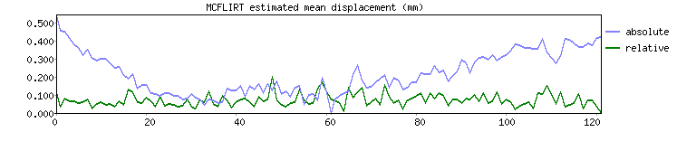
MCFLIRT output
Head rotation
Head translation
Total displacement
Notes:
In most cases it is sufficient to look at the total displacement graph. You only need to look at the individual directions of translation and rotation if there is a problem in the total displacement plot.
Points:
The rotation and translation plots are absolute with respect to the reference image in the middle of the time course. That’s why you can see bigger differences from zero near the beginning and end of the plots.
This participant had a lot of z motion (nodding of head producing z translation and rotation near start of scan)
This contrasts with the total displacement plot, where you have both absolute and relative motion plots. The mean relative displacement is the net amount of motion between consecutive functional volumes. The relative plot is really important (next slide).
When looking at the total displacement plot, the first thing you must do is look at the range of values on the y axis. PURPLE OVAL HIGHLIGHTS THIS. FSL autoscales the y axis to fit the data, so a participant like the one depicted here who only moved a total of 0.5 mm or so in the whole session will look the same as one who moved 3 times as much. So, check the y axis first. If the scale on the y axis has a max of about a 1mm or less don’t worry about that participant. If it is 3mm you should worry.
You have the option of entering the actual motion parameters to the GLM as regressors of no interest, but people disagree on whether this is worthwhile if you have also resampled the images to remove estimated motion. Adding motion parameters as regressors of no interest also uses up a lot of degrees of freedom in the data because you are adding 6 more regressors to the model. MELODIC ICA is also an interesting approach you could use if you needed to scan a population that was not good at keeping still.

Slide 10
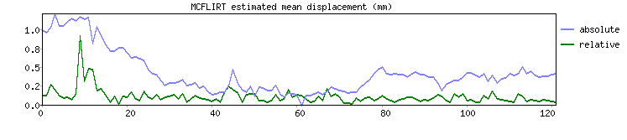
The total displacement plot
displacement is calculated relative to the volume in the middle of the time series
Relative displacement is head position at each time point relative to the previous time point. Absolute displacement is relative to the reference image.
Notes:
In this data set there were 120 volumes (TR), so the displacements are calculated relative to volume 60 in the series. Looking at the plot you can see that the absolute displacement tends to be greater at the start and end of the time series. This is simply because the middle point was arbitrarily chosen to be “zero”. This also explains why displacement is zero in the middle of the plot.

Slide 11
The total displacement plot
High values in the relative motion plot are particularly problematic. Why?
Rapid motion of boundaries through magnetic field produces big changes in image intensity
Regressors can be included to “model out” such “spikes”
Notes:
Note that large jumps in the relative motion plot are a serious issue. This is because they are likely to be accompanied by distortions in the image that are not properly compensated for by motion correction procedures**. They will then add a big chunk to your error term in the GLM, or produce false activation. You can try modelling such “spikes” out of the data with a single regressor that has a value of 1 where there are spikes, or a 0 elsewhere. [Don’t convolve that regressor with an HRF]. Slow drifts in the absolute motion plot are less problematic because the motion correction algorithm can deal with them better.
**Why is the image likely to be distorted around the point where there are spikes in the relative motion plot? Answer is because sudden head motion will have produced changes in the magnetic field and caused all sorts of small gradients as tissue type boundaries (particularly tissue to air boundaries at sinuses and near ears) are moved through the magnetic field. These gradients in turn influence the t2 relaxation time and can do very odd things to the image. So that’s why sudden big motion causes more problems than just a spatial displacement of the image
Something you should think about when comparing two groups (e.g. patients with normals) is do the two groups differ in how much they move, or the kind of motion they make in the scanner. If there were systematic differences in motion between the two groups it could conceivably produce false activation differences between them.

Slide 12
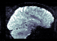
Slice timing correction
Each slice in a functional image is acquired separately.
Acquisition is normally interleaved, which prevents blending of signal from adjacent slices
Assuming a TR of 3 seconds, what is the time difference between the acquisition of adjacent slices?
A single functional brain area may span two or more slices
Notes:
The answer is 1.5 sec, and this is independent of the number of slices.
The blending of signal from adjacent slices that can occur with sequential top to bottom acquisition (or bottom to top) is caused by “spin history effects”

Slide 13
Why are the different slice timings a problem?
The same temporal model (design matrix) is fitted to every voxel time course
therefore, the model assumes that all the voxel values in a single functional volume were measured simultaneously
Given that they are not measured simultaneously, what are the implications?
Consider two voxels from same functional brain area, but located in nearby slices
In the following example the TR is 1.5, and there is a 1 sec time gap between acquisition of two voxels in the nearby slices that cover the functional brain area

Slide 14
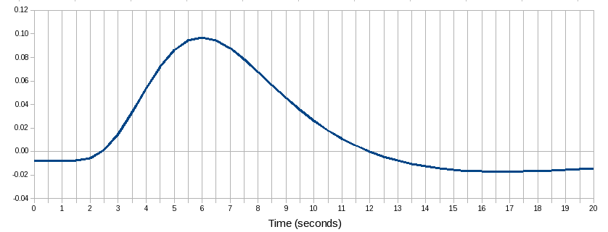
Blue line = real HRF in response to a brief event at time 0
Blue squares: intensity values at a voxel first sampled at 0.5 sec, then every 1.5 sec thereafter (TR = 1.5)
Red circles: intensity values at a voxel from an adjacent slice first sampled at 1.5 sec, then every 1.5 sec thereafter (TR = 1.5)

Slide 15
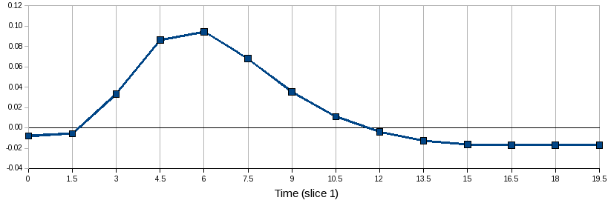
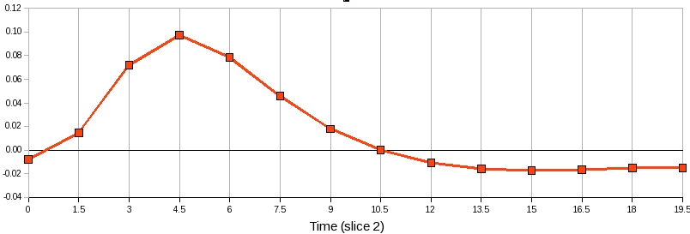
These are the two voxel time courses that are submitted to the model
Notes:
Notice that one voxel time course has the peak activation at 6 sec after the stimulus, and the other one at 4.5 sec after the stimulus! This is quite a big gap, and the problem would be more severe if the TR was 2.5 or 3 sec.

Slide 16
The model time course is yoked to the mid point of the volume acquisition (TR), so there will be a better fit for voxels in slices acquired at or near that time.
These are the two voxel time courses that are submitted to the model
Notes:
Notice that one voxel time course has the peak activation at 6 sec after the stimulus, and the other one at 4.5 sec after the stimulus! This is quite a big gap, and the problem would be more severe if the TR was 2.5 or 3 sec.

Slide 17
Slice timing solutions
Option 1
Including temporal derivatives of the main regressors in the model allows the model to be shifted in time to fit voxels in slices acquired far away from the mid point of the TR
But,
this makes it difficult to interpret the PE’s for the derivatives: do they represent slice timing, or do they represent variations in the underlying HRF between brain areas (or people)?
and, you end up having to use F contrasts instead of t contrasts (see later for why this is to be avoided if possible)

Slide 18
Slice timing solutions
Option 2
Use a block design with blocks long enough that the BOLD response is summated over a long time period
But,
Not all experimental stimuli / tasks can be presented in a block design
So, use option 3
Shift the data from different slices in time by small amounts so that it is as if all slices were acquired at once
this is what the preprocessing option in FEAT does

Slide 19
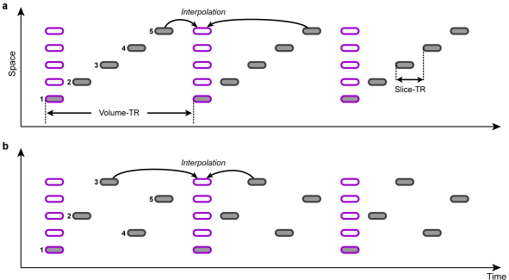
Shifting the data in time
But if the TR is 3 seconds, and you need to move the data for a given slice by, e.g., 1 sec, you don’t have a real data point to use
get round this by interpolating the missing time points to allow whole voxel time courses to be shifted in time so effectively they were all sampled at once at the middle of the TR
Notes:
The following discussion is from http://mindhive.mit.edu/node/109
Slice Timing FAQ
Frequently Asked Questions - Slice Timing Correction
SliceTimingPapers
SliceTimingHowTos
SliceTimingLinks
1. What is slice timing correction? What's the point?
In multi-shot EPI (or spiral methods, which mimic them on this front), slices of your functional images are acquired throughout your TR. You therefore sample the BOLD signal at different layers of the brain at different time points. But you'd really like to have the signal for the whole brain from the same time point. If a given region that spans two slices, for example, all activates at once, you want to see what the signal looks like from the whole region at once; without correcting for slice timing, you might think the part of the region that was sampled later was more active than the part sampled earlier, when in fact you just sampled from the later one at a point closer to the peak of its HRF.
What slice-timing correction does is, for each voxel, examine the timecourse and shift it by a small amount, interpolating between the points you ACTUALLY sampled to give you back the timecourse you WOULD have gotten had you sampled every voxel at exactly the same time. That way you can make the assumption, in your modeling, that every point in a given functional image is the actual signal from the same point in time.
2. How does it work?
The standard algorithm for slice timing correction uses sinc interpolation between time points, which is accomplished by a Fourier transform of the signal at each voxel. The Fourier transform renders any signal as the sum of some collection of scaled and phase-shifted sine waves; once you have the signal in that form, you can simply shift all the sines on a given slice of the brain forward or backward by the appropriate amount to get the appropriate interpolation. There are a couple pitfalls to this technique, mainly around the beginning and end of your run, highlighted in Calhoun et. al below, but these have largely been accounted for in the currently available modules for slice timing correction in the major programs.
3. Are there different methods or alternatives and how well do they work?
One alternative to doing slice-timing correction, detailed below in Henson et. al, is simply to model your data with an HRF that accounts for significant variability in when your HRFs onset - i.e., including regressors in your model that convolve your data with both a canonical HRF and with its first temporal derivative, which is accomplished with the 'hrf + temporal derivative' option in SPM. In terms of detecting sheer activation, this seems to be effective, despite the loss of some degrees of freedom in your model; however, your efficiency in estimating your HRF is very significantly reduced by this method, so if you're interested in early vs. late comparisons or timecourse data, this method isn't particularly useful.
Another option might be to include slice-specific regressors in your model, but I don't know of any program that currently implements this option, or any papers than report on it...
4. When should you use it?
Slice timing correction is primarily important in event-related experiments, and especially if you're interested in doing any kind of timecourse analysis, or any type of 'early-onset vs. late-onset' comparison. In event-related experiments, however, it's very important; Henson et. al show that aligning your model's timescale to the top or bottom slice can results in completely missing large clusters on the slice opposite to the reference slice without doing slice timing correction. This problem is magnified if you're doing interleaved EPI; any sequence that places adjacent slices at distant temporal points will be especially affected by this issue. Any event-related experiment should probably use it.
5. When is it a bad idea?
It's never that bad an idea, but because the most your signal could be distorted is by one TR, this type of correction isn't as important in block designs. Blocks last for many TRs and figuring out what's happening at any given single TR is not generally a priority, and although the interpolation errors introduced by slice timing correction are generally small, if they're not needed, there's not necessarily a point to introducing them. But if you're interested in doing any sort of timecourse analysis (or if you're using interleaved EPI), it's probably worthwhile.
6. How do you know if it’s working?
Henson et. al and both Van de Moortele papers below have images of slice-time-corrected vs. un-slice-time-corrected data, and they demonstrate signatures you might look for in your data. Main characteristics might be the absence of significant differences between adjacent slices. I hope to post some pictures here in the next couple weeks of the SPM sample data, analyzed with and without slice timing correction, to explore in a more obvious way.
7. At what point in the processing stream should you use it?
This is the great open question about slice timing, and it's not super-answerable. Both SPM and AFNI recommend you do it before doing realignment/motion correction, but it's not entirely clear why. The issue is this:
If you do slice timing correction before realignment, you might look down your non-realigned timecourse for a given voxel on the border of gray matter and CSF, say, and see one TR where the head moved and the voxel sampled from CSF instead of gray. This would results in an interpolation error for that voxel, as it would attempt to interpolate part of that big giant signal into the previous voxel.
On the other hand, if you do realignment before slice timing correction, you might shift a voxel or a set of voxels onto a different slice, and then you'd apply the wrong amount of slice timing correction to them when you corrected - you'd be shifting the signal as if it had come from slice 20, say, when it actually came from slice 19, and shouldn't be shifted as much.
There's no way to avoid all the error (short of doing a four-dimensional realignment process combining spatial and temporal correction - possibly coming soon), but I believe the current thinking is that doing slice timing first minimizes your possible error. The set of voxels subject to such an interpolation error is small, and the interpolation into another TR will also be small and will only affect a few TRs in the timecourse. By contrast, if one realigns first, many voxels in a slice could be affected at once, and their whole timecourses will be affected. I think that's why it makes sense to do slice timing first. That said, here's some articles from the SPM e-mail list that comment helpfully on this subject both ways, and there are even more if you do a search for "slice timing AND before" in the archives of the list.
Thread from Rik Henson
Argument from Geoff Aguirre
Response to Aguirre from Ashburner
8. How should you choose your reference slice?
You can choose to temporally align your slices to any slice you've taken, but keep in mind that the further away from the reference slice a given slice is, the more it's being interpolated. Any interpolation generates some small error, so the further away the slice, the more error there will be. For this reason, many people recommend using the middle slice of the brain as a reference, minimizing the possible distance away from the reference for any slice in the brain. If you have a structure you're interested in a priori, though - hippocampus, say - it may be wise to choose a slice close to that structure, to minimize what small interpolation errors may crop up.
9. Is there some systematic bias for slices far away from your reference slice, because they're always being sampled at a different point in their HRF than your reference slice is?
That's basically the issue of interpolation error - the further away from your reference slice you are, the more error you're going to have in your interpolation - because your look at the "right" timepoint is a lot blurrier. If you never sample the slice at the top of the head at the peak of the HRF, the interpolation can't be perfect there if you're interpolating to a time when the HRF should be peaking - but hopefully you have enough information about your HRF in your experiment to get a good estimation from other voxels. It's another argument for choosing the middle slice in your image - you want to get as much brain as possible in an area of low interpolation error (close to the reference slice).
10. How can you be sure you're not introducing more noise with interpolation errors than you're taking out with the correction?
Pretty good question. I don't know enough about signal processing and interpolation to say exactly how big the interpolation errors are, but the empirical studies below seem to show a significant benefit in detection by doing correction without adding much noise or many false positive voxels. Anyone have any other comments about this?
CategoryFaq
‹ Segmentation Papers up Slice Timing HOWTO ›
Posted by admin on Wed, 04/30/2008 - 19:06
Login to post comments
Search
Search this site:
Navigation
Recent posts
User login
Username: *
Password: *
Request new password
C

Slide 20
Shifting the data in time - caveats
But…
Interpolation works OK for short TR, but it does not work well for long TR (> 3 sec?)
So this solution only works well when slice timing issues are relatively minor
There is a debate about whether to do slice timing correction before or after motion correction
FSL does motion correction first
some people advise against any slice timing correction
Generally, if you have an event related design then use it, but make sure you check carefully with the scanner technician what order your slices were acquired in!

Slide 21
Temporal filtering
Filtering in time and/or space is a long-established method in any signal detection process to help "clean up" your signal
The idea is if your signal and noise are present at separable frequencies in the data, you can attenuate the noise frequencies and thus increase your signal to noise ratio
Notes:
1. Why do filtering? What’s it buy you?
Filtering in time and/or space is a long-established method in any signal detection process to help "clean up" your signal. The idea is if your signal and noise are present at separable frequencies in the data, you can attenuate the noise frequencies and thus increase your signal to noise ratio.
One obvious way you might do this is by knocking out frequencies you know are too low to correspond to the signal you want - in other words, if you have an idea of how fast your signal might be oscillating, you can knock out noise that is oscillating much slower than that. In fMRI, noise like this can have a number of courses - slow "scanner drifts," where the mean of the data drifts up or down gradually over the course of the session, or physiological influences like changes in basal metabolism, or a number of other sources. This type of filtering is called "high-pass filtering," because we remove the very low frequencies and "pass through" the high frequencies. Doing this in the spatial domain would correspond to highlighting the edges of your image (preserving high-frequency information); in the temporal domain, it corresponds to "straightening out" any large bends or drifts in your timecourse. Removing linear drifts from a timecourse is the simplest possible high-pass filter.
Another obvious way you might do this would be the opposite - knock out the frequencies you know are too high to correspond to your signal. This removes noise that is oscillating much faster than your signal from the data. This type of filtering is called "low-pass filtering," because we remove the very high frequencies and "pass through" the low frequencies. Doing this in the spatial domain is simply spatial smoothing (see SmoothingFaq); in the temporal domain, it corresponds to temporal smoothing. Low-pass filtering in fmri is much more controversial than high-pass filtering, a controversy explored by the papers in TemporalFilteringPapers.
Finally, you could apply combinations of these filters to try and restrict the signal you detect to a specific band of frequencies, preserving only oscillations faster than a certain speed and slower than a certain speed. This is called "band-pass filtering," because we "pass through" a band of frequencies and filter everything else out, and is usually implemented in neuroimaging as simply doing both high-pass and low-pass filtering separately.
In all of these cases, the goal of temporal filtering is the same: to apply our knowledge about what the BOLD signal "should" look like in the temporal domain in order to remove noise that is very unlikely to be part of the signal. This buys us better SNR, and a much better chance of detecting real activations and rejecting false ones.
2. What actually happens to my signal when I filter it? How about the design matrix?
Filtering is a pretty standard mathematical operation, so all the major neuroimaging programs essentially do it the same way. We'll use high-pass as an example, as low-pass is no longer standard in most neuroimaging programs. At some point before model estimation, the program will ask the user to specify a cutoff parameter in Hz or seconds for the filter. If specified in seconds, this cutoff is taken to mean the period of interest of the experiment; frequencies that repeat over a timescale longer than the specified cutoff parameter are removed. Once the design matrix is constructed but before model estimation has begun, the program will filter each voxel's timecourse (the filter is generally based on some discrete cosine matrix) before submitting it to the model estimation - usually a very quick process. A graphical representation of the timecourse would show a "straightening out" of the signal timecourse - oftentime timecourses will have gradual linear drifts or quadratic drifts, or even higher frequency but still gradual bends, which are all flattened away after the filtering.
Other, older methods for high-pass filtering simply included a set of increasing-frequency cosines in the design matrix (see Holmes et. al below), allowing them to "soak up" low-frequency variance, but this is generally not done explicitly any more.
Low-pass filtering proceeds much the same way, but the design matrix is also usually filtered to smooth out any high frequencies present in it, as the signal to be detected will no longer have them. Low-pass filters are less likely to be specified merely with a lower-bound period-of-interest cutoff; oftentimes low-pass filters are constructed deliberately to have the same shape as a canonical HRF, to help highlight signal with that shape (as per the matched-filter theorem).
3. What’s good about high-pass filtering? Bad?
High-pass filtering is relatively uncontroversial, and is generally accepted as a good idea for neuroimaging data. One big reason for this is that the noise in fMRI isn't white - it's disproportionately present in the low frequencies. There are several sources for this noise (see PhysiologyFaq and BasicStatisticalModelingFaq for discussions of some of them), and they're expressed in the timecourses sometimes as linear or higher-order drifts in the mean of the data, sometimes as slightly faster but still gradual oscillations (or both). What's good about high-pass filtering is that it's a straightforward operation that can attenuate that noise to a great degree. A number of the papers below study the efficacy of preprocessing steps, and generally it's found to significantly enhance one's ability to detect true activations.
The one downside of high-pass filtering is that it can sometimes be tricky to select exactly what one's period of interest is. If you only have a single trial type with some inter-trial interval, then your period of interest of obvious - the time from one trial's beginning to the next - but what if you have three or four? Or more than that? Is it still the time from one trial to the next? Or the time from one trial to the next trial of that same type? Or what? Skudlarski et. al (TemporalFilteringPapers) point out that a badly chosen cutoff period can be significantly worse than the simplest possible temporal filtering, which would just be removing any linear drift from the data. If you try and detect an effect whose frequency is lower than your cutoff, the filter will probably knock it completely out, along with the noise. On the other hand, there's enough noise at low frequencies to almost guarantee that you wouldn't be able to detect most very slow anyways. Perfusion imaging does not suffer from this problem, one of its benefits - the noise spectrum for perfusion imaging appears to be quite flat.
4. What’s good about low-pass filtering? Bad?
Low-pass filtering is much more controversial in MRI, and even in the face of mounting empirical evidence that it wasn't doing much good, the SPM group long offered some substantial and reasonable arguments in favor of it. The two big reasons offered in favor of low-pass filtering broke down as:
The matched-filter theorem suggests filtering our timecourse with a filter shaped like an HRF should enhance signals of that shape relative to the noise, and
We need to modify our general linear model to account for all the autocorrelation in fMRI noise; one way of doing that is by conditioning our data with a low-pass filter - essentially 'coloring' the noise spectrum, or introducing our own autocorrelations - and assuming that our introduced autocorrelation 'swamps' the existing autocorrelations, so that they can be ignored. (See BasicStatisticalModelingFaq for more on this.) This was a way of getting around early ignorance about the shape of the noise spectrum in fMRI and avoiding the computational burden of approximating the autocorrelation function for each model. Even as those burdens began to be overcome, Friston et. al (TemporalFilteringPapers) pointed out potential problems with pre-whitening the data as opposed to low-pass filtering, relating to potential biases of the analysis.
However, the mounting evidence demonstrating the failure of low-pass filtering, as well as advances in computation speed enabling better ways of dealing with autocorrelation, seem to have won the day. In practice, low-pass filtering seems to have the effect of greatly reducing one's sensitivity to detecting true activations without significantly enhancing the ability to reject false ones (see Skudlarksi et. al, Della-Maggiore et. al on TemporalFilteringPapers). The problem with low-pass filtering seems to be that because noise is not independent from timepoint to timepoint in fMRI, 'smoothing' the timecourse doesn't suppress the noise but can, in fact, enhance it relative to the signal - it amplifies the worst of the noise and smooths the peaks of the signal out. Simulations with white noise show significant benefits from low-pass filtering, but with real, correlated fMRI noise, the filtering because counter-effective. Due to these results and a better sense now of how to correctly pre-whiten the timeseries noise, low-pass filtering is now no longer available in SPM2, nor is it allowed by standard methods in AFNI or BrainVoyager.
5. How do you set your cutoff parameter?
Weeeeelll... this is one of those many messy little questions in fMRI that has been kind of arbitrarily hand-waved away, because there's not a good, simple answer for it. You'd to like to filter out as much noise as possible - particularly in the nasty part of the noise power spectrum where the noise power increases abruptly - without removing any important signal at all. But this can be a little trickier than it sounds. Roughly, a good rule of thumb might be to take the 'fundamental frequency' of your experiment - the time between one trial start and the next - and double or triple it, to make sure you don't filter out anything closer to your fundamental frequency.
SPM99 (and earlier) had a formula built in that would try and calculate this number. But if you had a lot of trial types, and some types weren't repeated for very long periods of time, you'd often get filter sizes that were way too long (letting in too much noise). So in SPM2 they scrapped the formula and now issue a default filter size of 128 seconds for everybody, which isn't really any better of a solution.
In general, default sizes of 100 or 128 seconds are pretty standard for most trial lengths (say, 8-45 seconds). If you have particularly short trials (less than 10 seconds) you could probably go shorter, maybe more like 60 or 48 seconds. But this is a pretty arbitrary part of the process. The upside is that it's hard to criticize an exact number that's in the right ballpark, so you probably won't get a paper rejected purely because your filter size was all wrong.

Slide 22
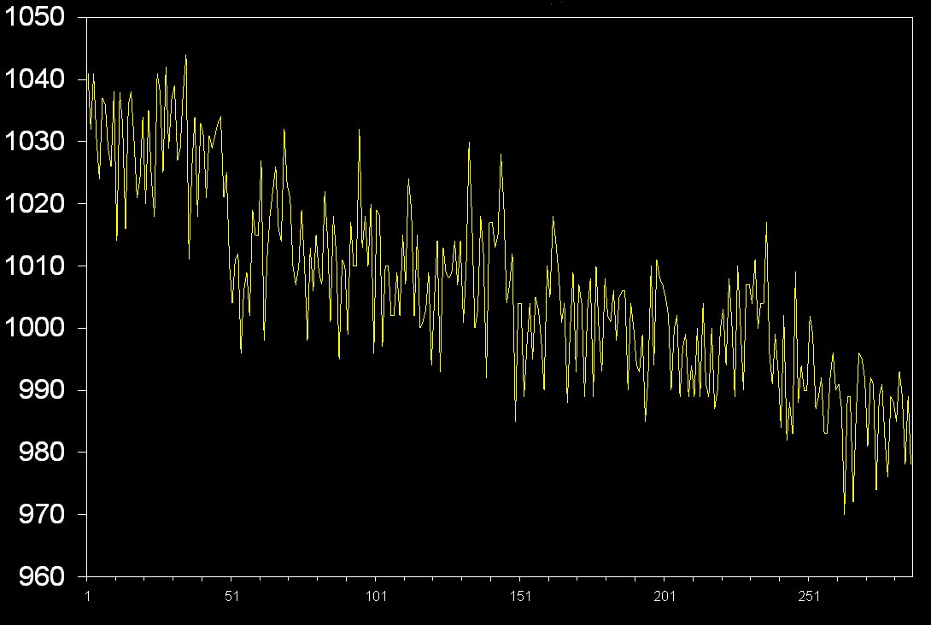
AAAAAAAVVVVVVVRRRRRRRAAAAAAAVVVVVVVRRRRRRR
Notes:
For example, this real voxel time course has low frequency drift, high frequency noise, and maybe some signal at the period of the experimental design, but this is hidden by the sources of noise.
In fMRI, the low frequency noise like can have a number of courses - slow "scanner drifts," where the mean of the data drifts up or down gradually over the course of the session, or physiological influences like changes in basal metabolism, or a number of other sources.
We do not generally attempt to filter out the high frequency noise because this has nasty unintended consequences. See temporal autocorrelation later.

Slide 23
AAAAAAAVVVVVVVRRRRRRRAAAAAAAVVVVVVVRRRRRRR
Time
Notes:
A = auditory stimulation
V = visual stimulation
R = Rest block
Block last about 16 seconds each.
The experiment has a periodic (repetitive) structure in time. One cycle of the experiment is the first 3 blocks in this example.
If a voxel had a time course that looked like the top image it would be oscillating at a period much higher than the experimental period.
If a voxel had a time course that looked like the middle on it would be oscillating at a period much lower than the experimental period (assuming it eventually begins to rise again)
If a voxel had a time course like the bottom one it would have a period very similar to the experimental time course, and its period would be peaking on the Visual block – looks like a visual cortex voxel!
The problem is that the activation of a voxel often looks like the sum of these 3 lines!

Slide 24
Temporal filtering – where does the noise come from?
Low frequency noise in voxel time courses can have physiological causes
participant becoming sleepy, or digesting a meal
Low frequency noise can also arise from imperfections in the MRI scanner
After “shimming” optimises the magnetic field homogeneity and strength for a particular participant, a slow drift away from the optimum will then occur
this in turn influences the resonant frequency of the hydrogen atoms
High frequency noise can come from
pulsatile blood supply
scanner “thermal noise”
more when then RF coil heats up
Notes:
Thermal noise is caused by the thermal movement of electrons in both the subject and the scanner over time. Radiofrequency signals emitted following excitation are processed in the scanner. As this processing occurs, within the electronics free electrons collide with atoms and energy is exchanged. These collisions cause the distortion of images. Thermal noise depends on temperature and frequency of the receiver and the resistance of the detector coil. The higher the temperature, the faster the molecules are moving and the more frequent collisions occur. The magnitude of thermal noise does not spatially correspond to voxels rather its signal amplitude. Across the brain, the distribution of thermal noise follows a Gaussian curve because thermal noise may either add or subtract from signal intensity. 7. What is the difference between thermal noise and system noise? What are common causes of system noise? Thermal noise is due to motion of atoms and electrons, which is random and cannot
http://fmri.pbworks.com/w/page/29041985/Chapter%208

Slide 25
Raw data (brief stimulus every 25 sec)
Notes:
Data from my replication and extension of Angelo Mosso (1870) “Using a lever to measure changes in cerebral blood volume related to mental activity”

Slide 26
After low pass filter
Notes:
Low pass filter was 6 second hanning window

Slide 27
Very low frequency component, suggests that high pass filter also needed
Notes:
If you remove some low frequencies and some high frequencies to leave a range in the middle this is band-pass filtering.
I knew that this slow drift could not be stimulus related because the stimulus was occurring every 25 sec, and this trend has a period of about 6 minutes!

Slide 28
Low and high frequencies removed
Notes:
If you compare this plot with the raw data plot you can see intuitively that a lot of the noise is removed. By this I mean that the standard deviation across time is much reduced. In this data there was a stimulus presented once every 25 sec for 10 minutes. I removed frequencies that were higher and lower than these frequencies. removing high and low is called band pass filtering

Slide 29
Setting the high pass filter for FMRI
The rule recommended by FSL is that the lowest setting for the high pass filter should be equal to the duration of a single cycle of the design
In an ABCABCABC block design, it will be equal to ABC
If you set a shorter duration than this you will remove signal that is associated with the experiment
If you set a higher duration than this then any unsystematic variation (noise) in the data with a periodic structure lower in frequency than the experimental cycle time will remain in voxel time courses
In complicated event related designs lacking a strongly periodic structure there is a subjective element to the setting of the high pass filter
Notes:
The one downside of high-pass filtering is that it can sometimes be tricky to select exactly what one's period of interest is. If you only have a single trial type with some inter-trial interval, then your period of interest of obvious - the time from one trial's beginning to the next - but what if you have three or four? Or more than that? Is it still the time from one trial to the next? Or the time from one trial to the next trial of that same type? Or what? Skudlarski et. al (TemporalFilteringPapers) point out that a badly chosen cutoff period can be significantly worse than the simplest possible temporal filtering, which would just be removing any linear drift from the data. If you try and detect an effect whose frequency is lower than your cutoff, the filter will probably knock it completely out, along with the noise. On the other hand, there's enough noise at low frequencies to almost guarantee that you wouldn't be able to detect most very slow experimentally induced oscillations anyways. Perfusion imaging does not suffer from this problem, one of its benefits - the noise spectrum for perfusion imaging appears to be quite flat.

Slide 30
Setting the high pass filter for FMRI
Do not use experimental designs with many conditions where the duration of a single experimental cycle is very long
e.g. ABCDEABCDE, where ABCDE = 300 seconds
setting the high pass to 300 sec will allow a lot of the low frequency FMRI noise to pass through to the modelling stage
Furthermore, the noise can easily become correlated with the experimental time course because you are using an experimental time course that has a similar frequency to that of FMRI noise
In any signal detection experiment, not just FMRI, you need to ensure that the signal of interest and noise are present at different temporal frequencies

Slide 31
Low pass filter?
As well as removing oscillations with a longer cycle time than the experiment, you can also elect to remove oscillations with a higher cycle time than the experiment
high frequency noise
In theory this should enhance signal and reduce noise, and this was practiced in the early days of FMRI
However, it has now been demonstrated that because FMRI noise has temporal structure (i.e. it is not white noise), the low pass filter can actually enhance noise relative to signal
The temporal structure in the noise is called “temporal autocorrelation” and is dealt with in FSL using FILM prewhitening instead of low pass filtering
in a break with the traditional structure of FMRI courses temporal autocorrelation and spatial smoothing will be covered after t and F contrasts
Notes:
However, the mounting evidence demonstrating the failure of low-pass filtering, as well as advances in computation speed enabling better ways of dealing with autocorrelation, seem to have won the day. In practice, low-pass filtering seems to have the effect of greatly reducing one's sensitivity to detecting true activations without significantly enhancing the ability to reject false ones (see Skudlarksi et. al, Della-Maggiore et. al on TemporalFilteringPapers). The problem with low-pass filtering seems to be that because noise is not independent from timepoint to timepoint in fMRI, 'smoothing' the timecourse doesn't suppress the noise but can, in fact, enhance it relative to the signal - it amplifies the worst of the noise and smooths the peaks of the signal out. Simulations with white noise show significant benefits from low-pass filtering, but with real, correlated fMRI noise, the filtering because counter-effective. Due to these results and a better sense now of how to correctly pre-whiten the timeseries noise, low-pass filtering is now no longer available in SPM2, nor is it allowed by standard methods in AFNI or BrainVoyager.

Slide 32
Standardised preprocessing pipelines?

